Slide 1
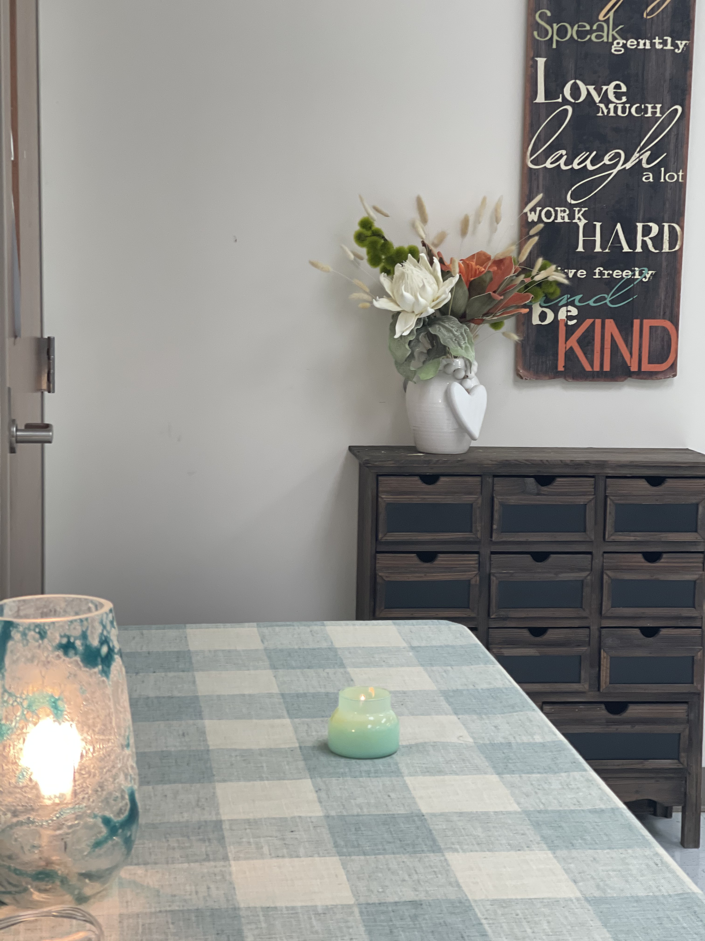
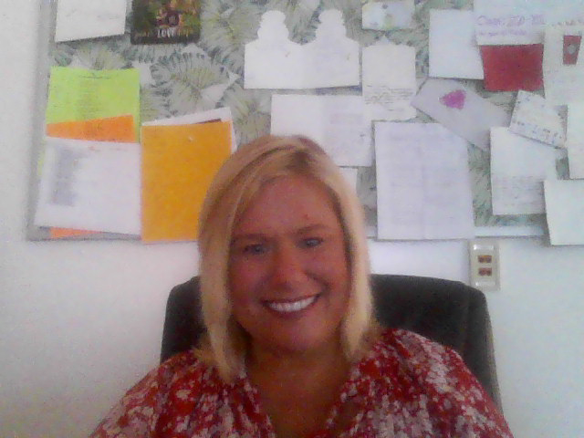
Mrs. Gaskin’s 7th grade classes 2021-2022
This slide show is a great memento of all of the learning and fun activities we are accomplishing this year.

Slide 2
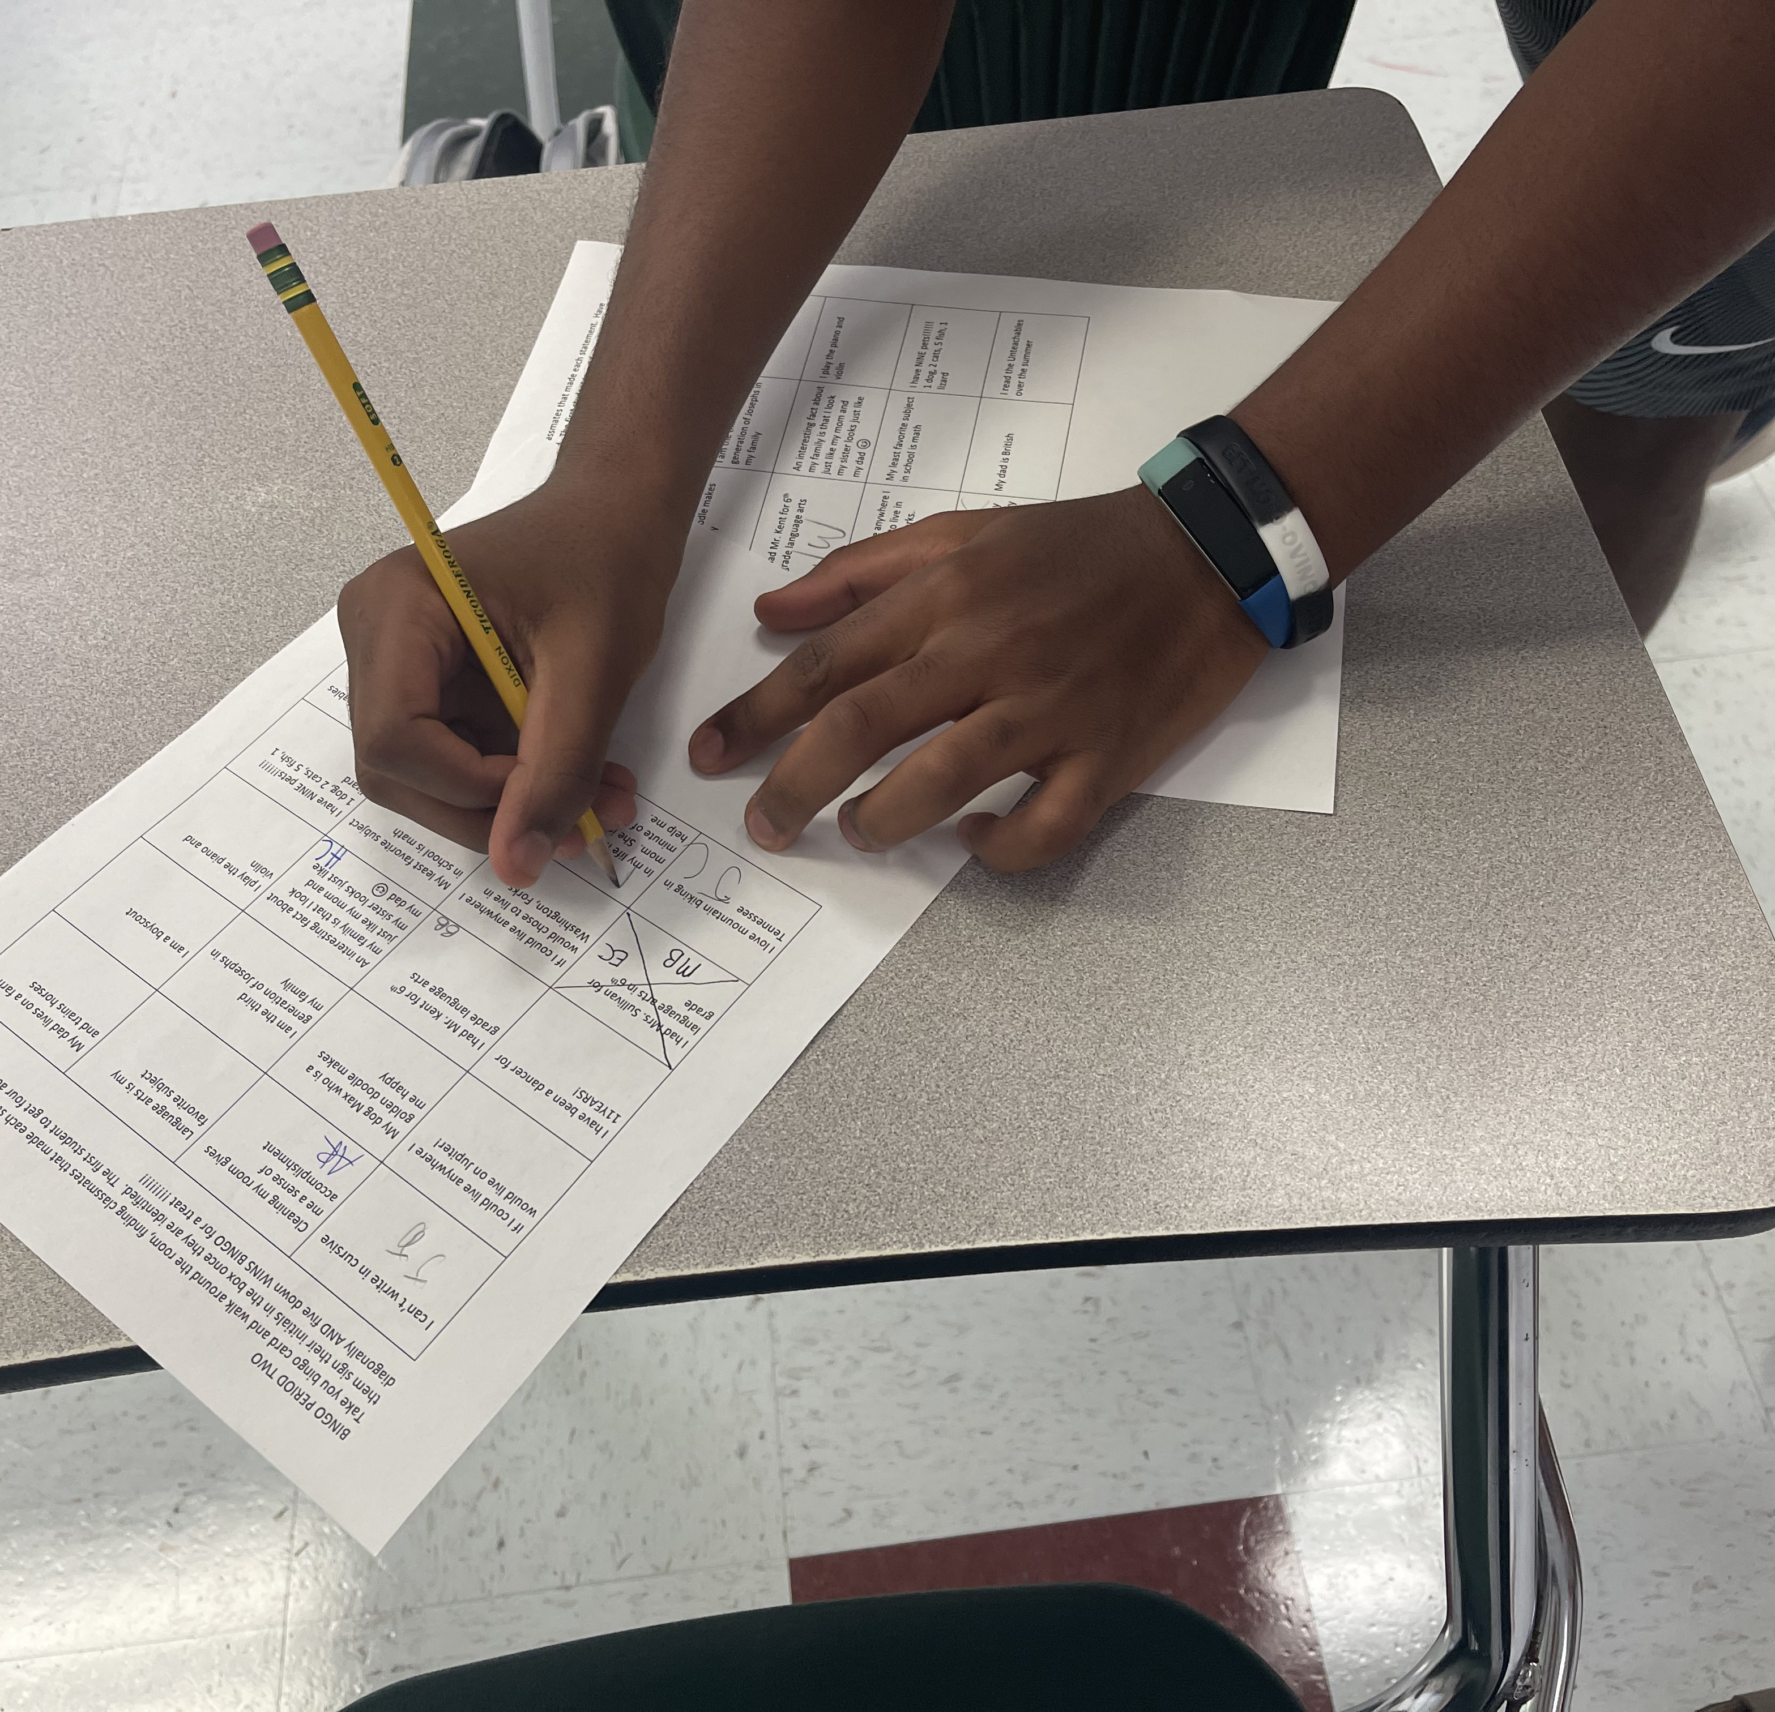
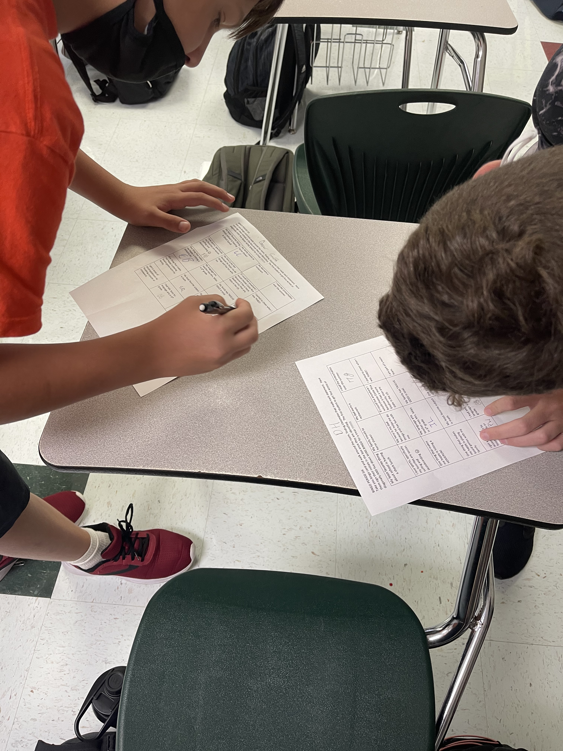
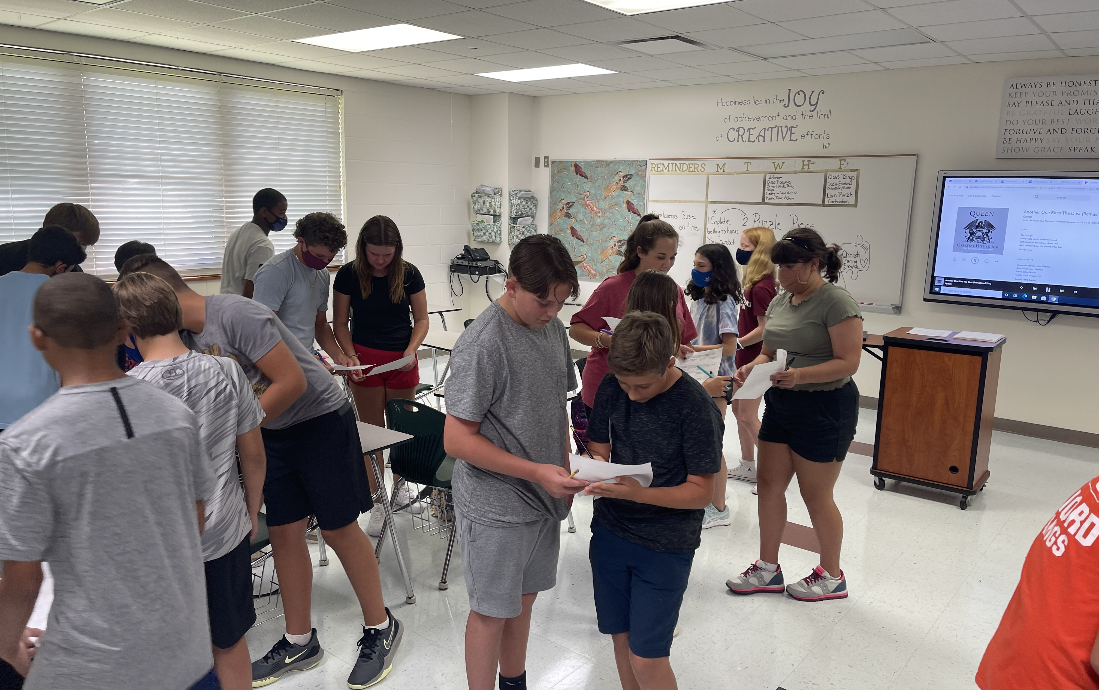
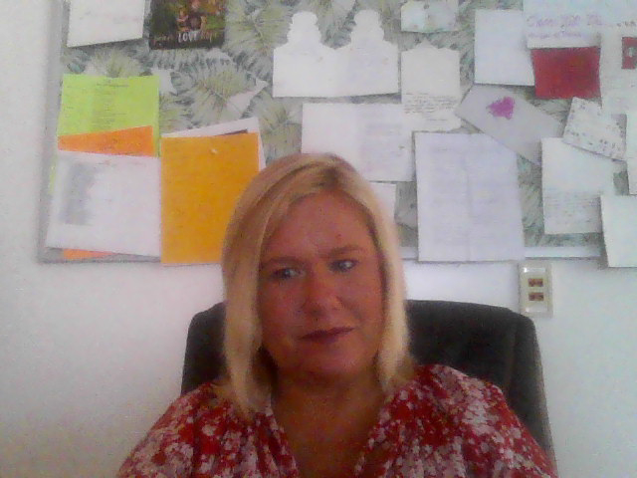
How We Started: The First Day
GETTING TO KNOW YOU HANDOUT AND CLASS BINGO!
Notes:
Add photos of the first days of school – or the first weeks. Include a first day quote from students if you have them.

Slide 3
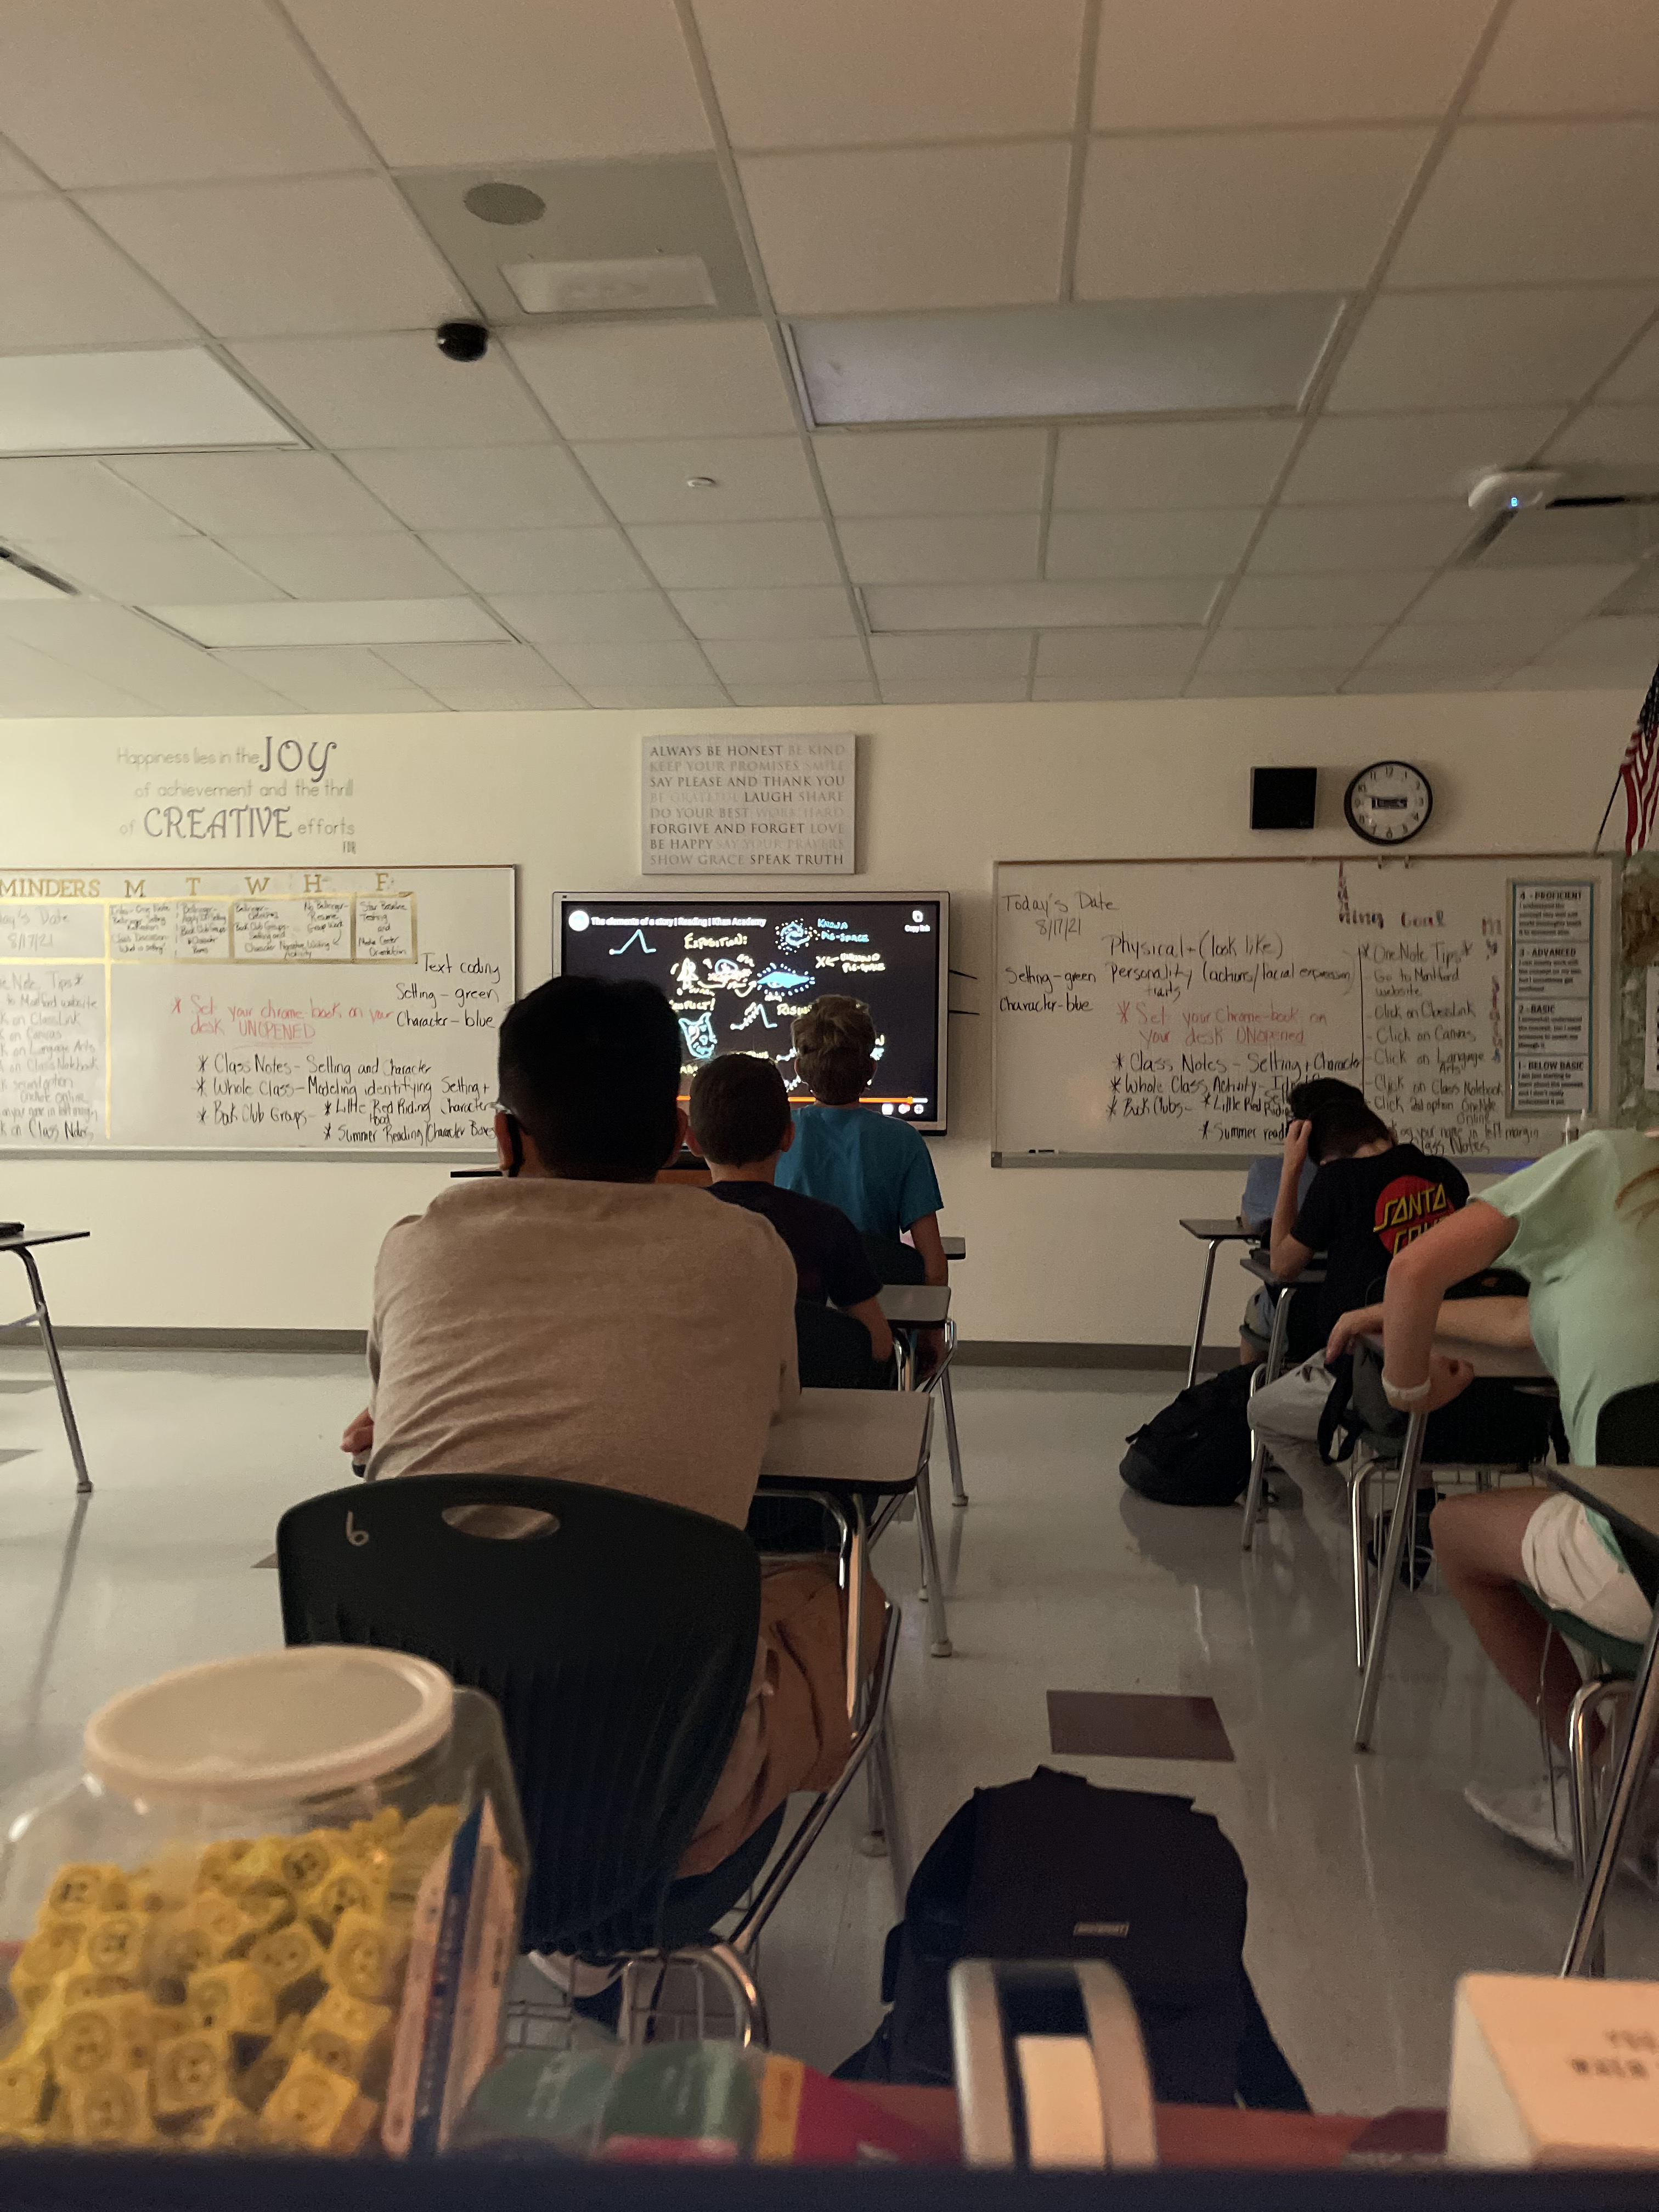
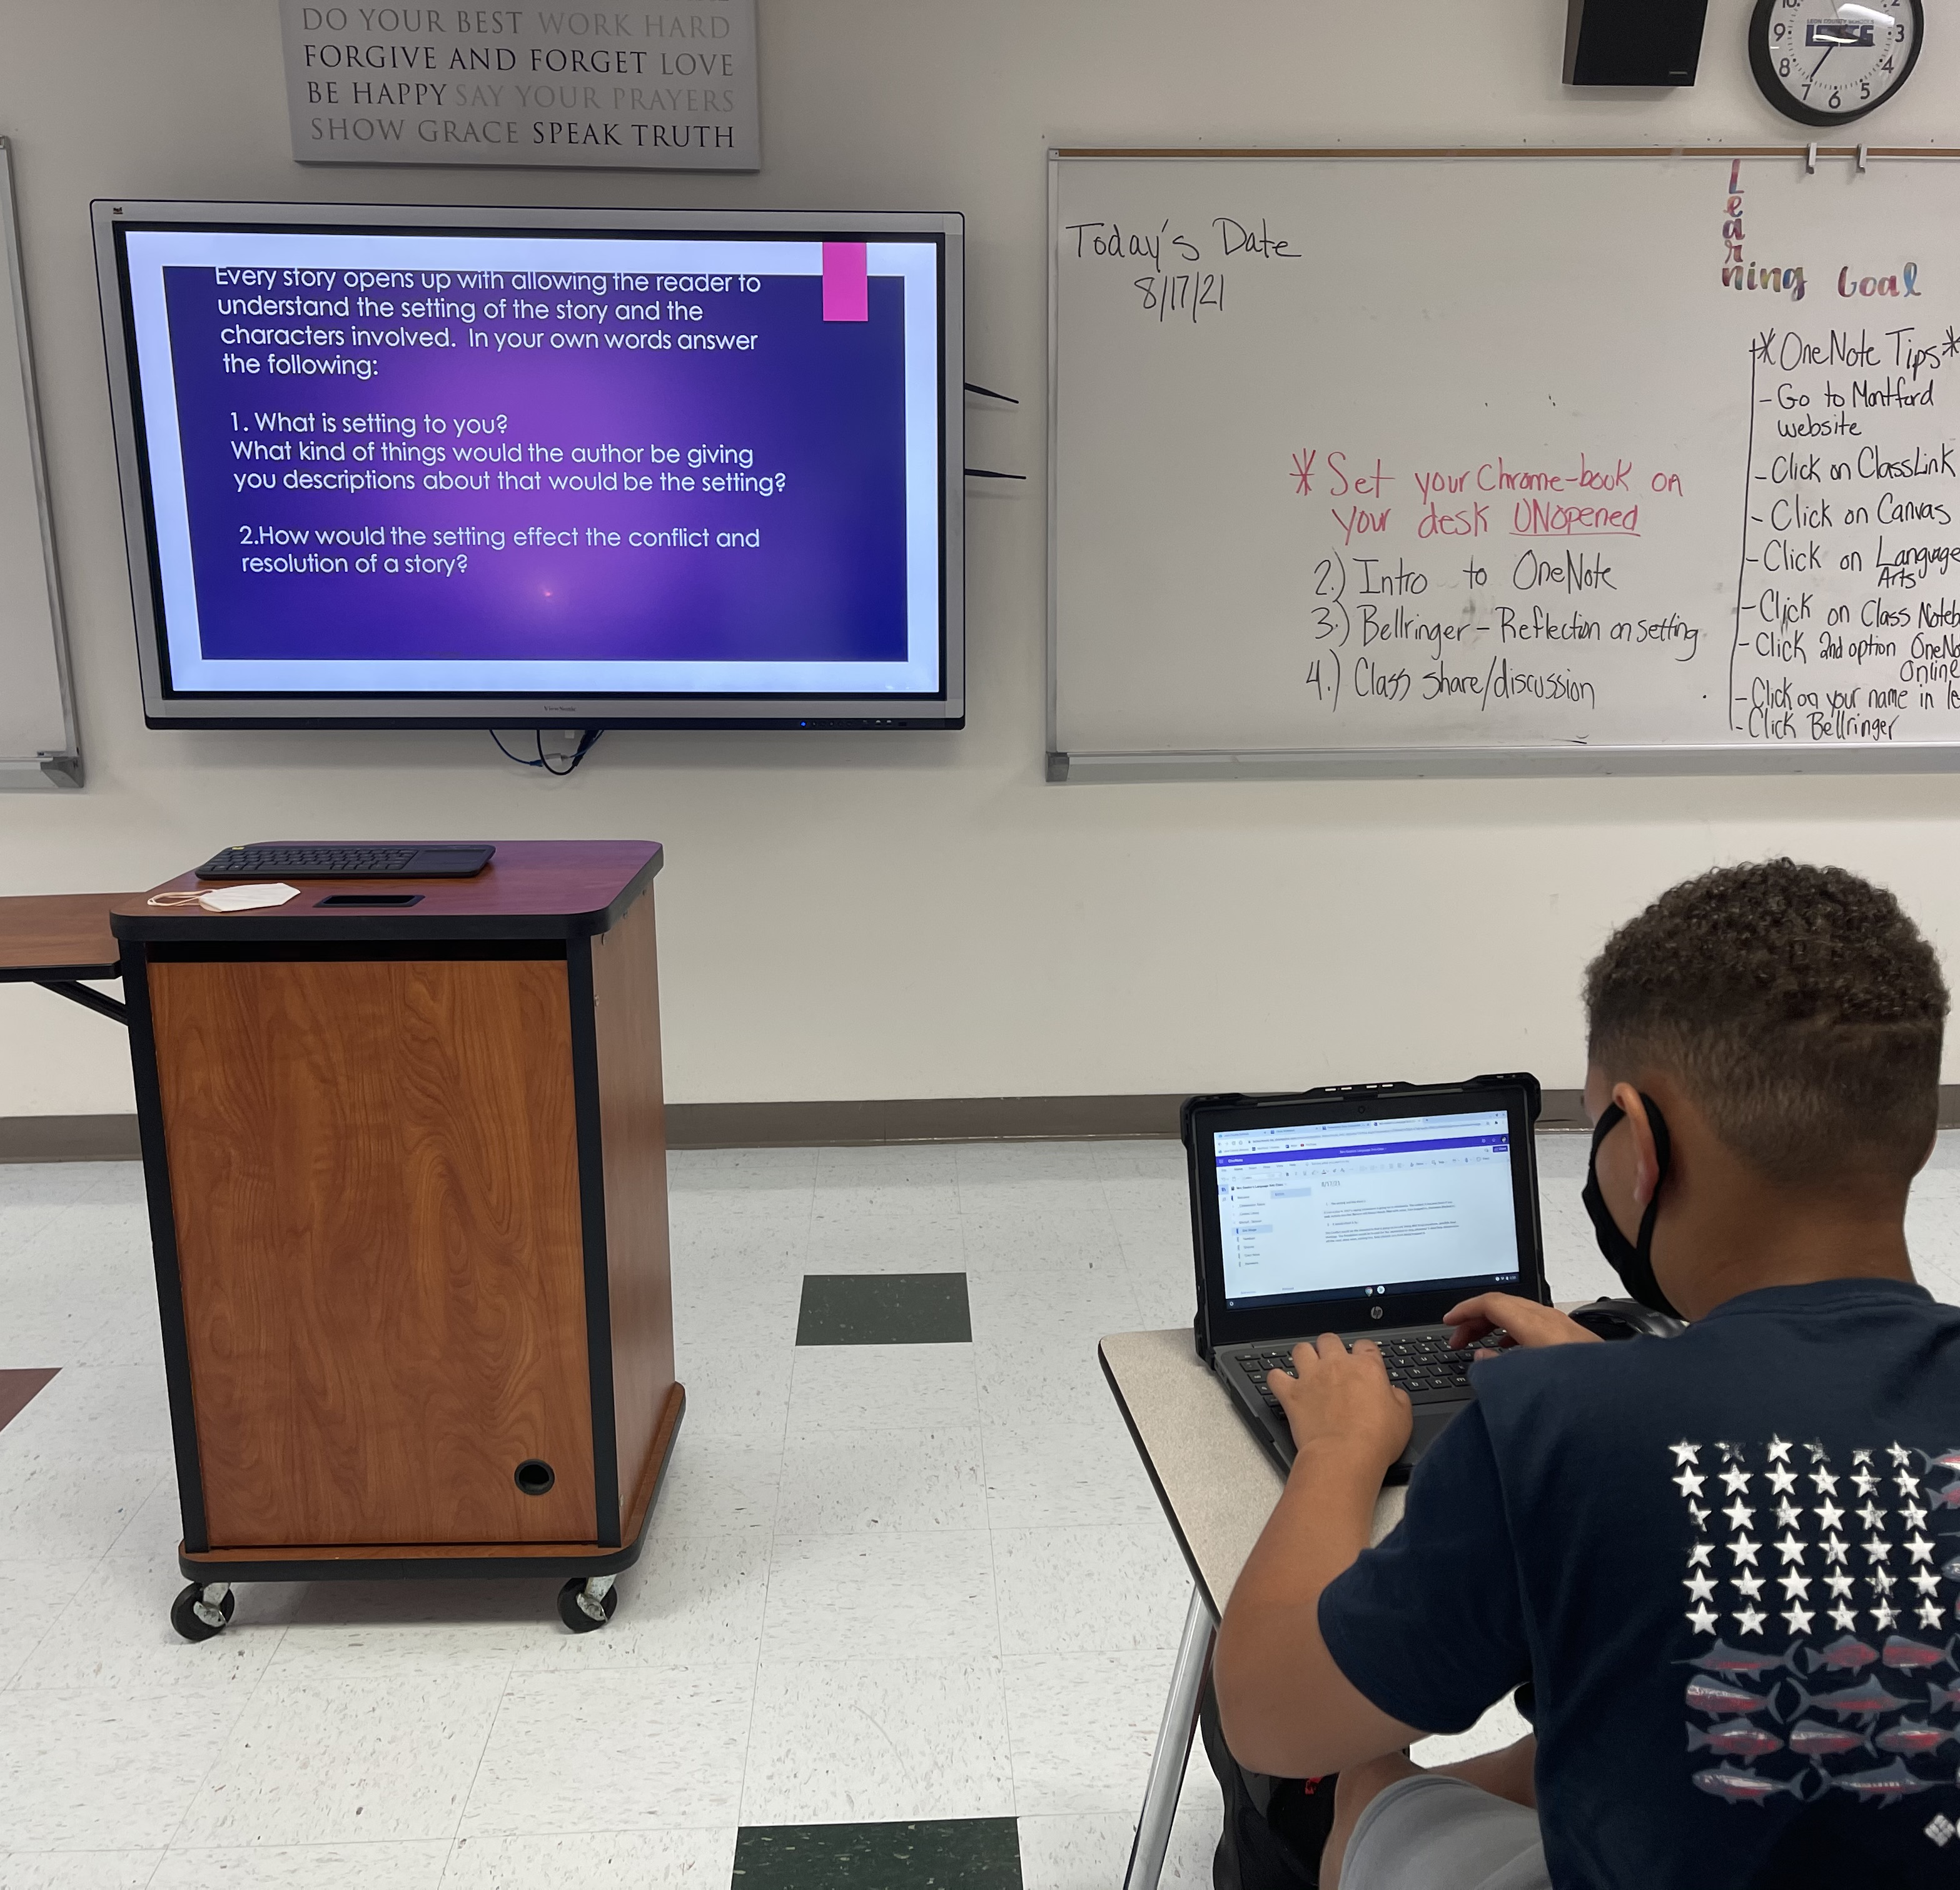
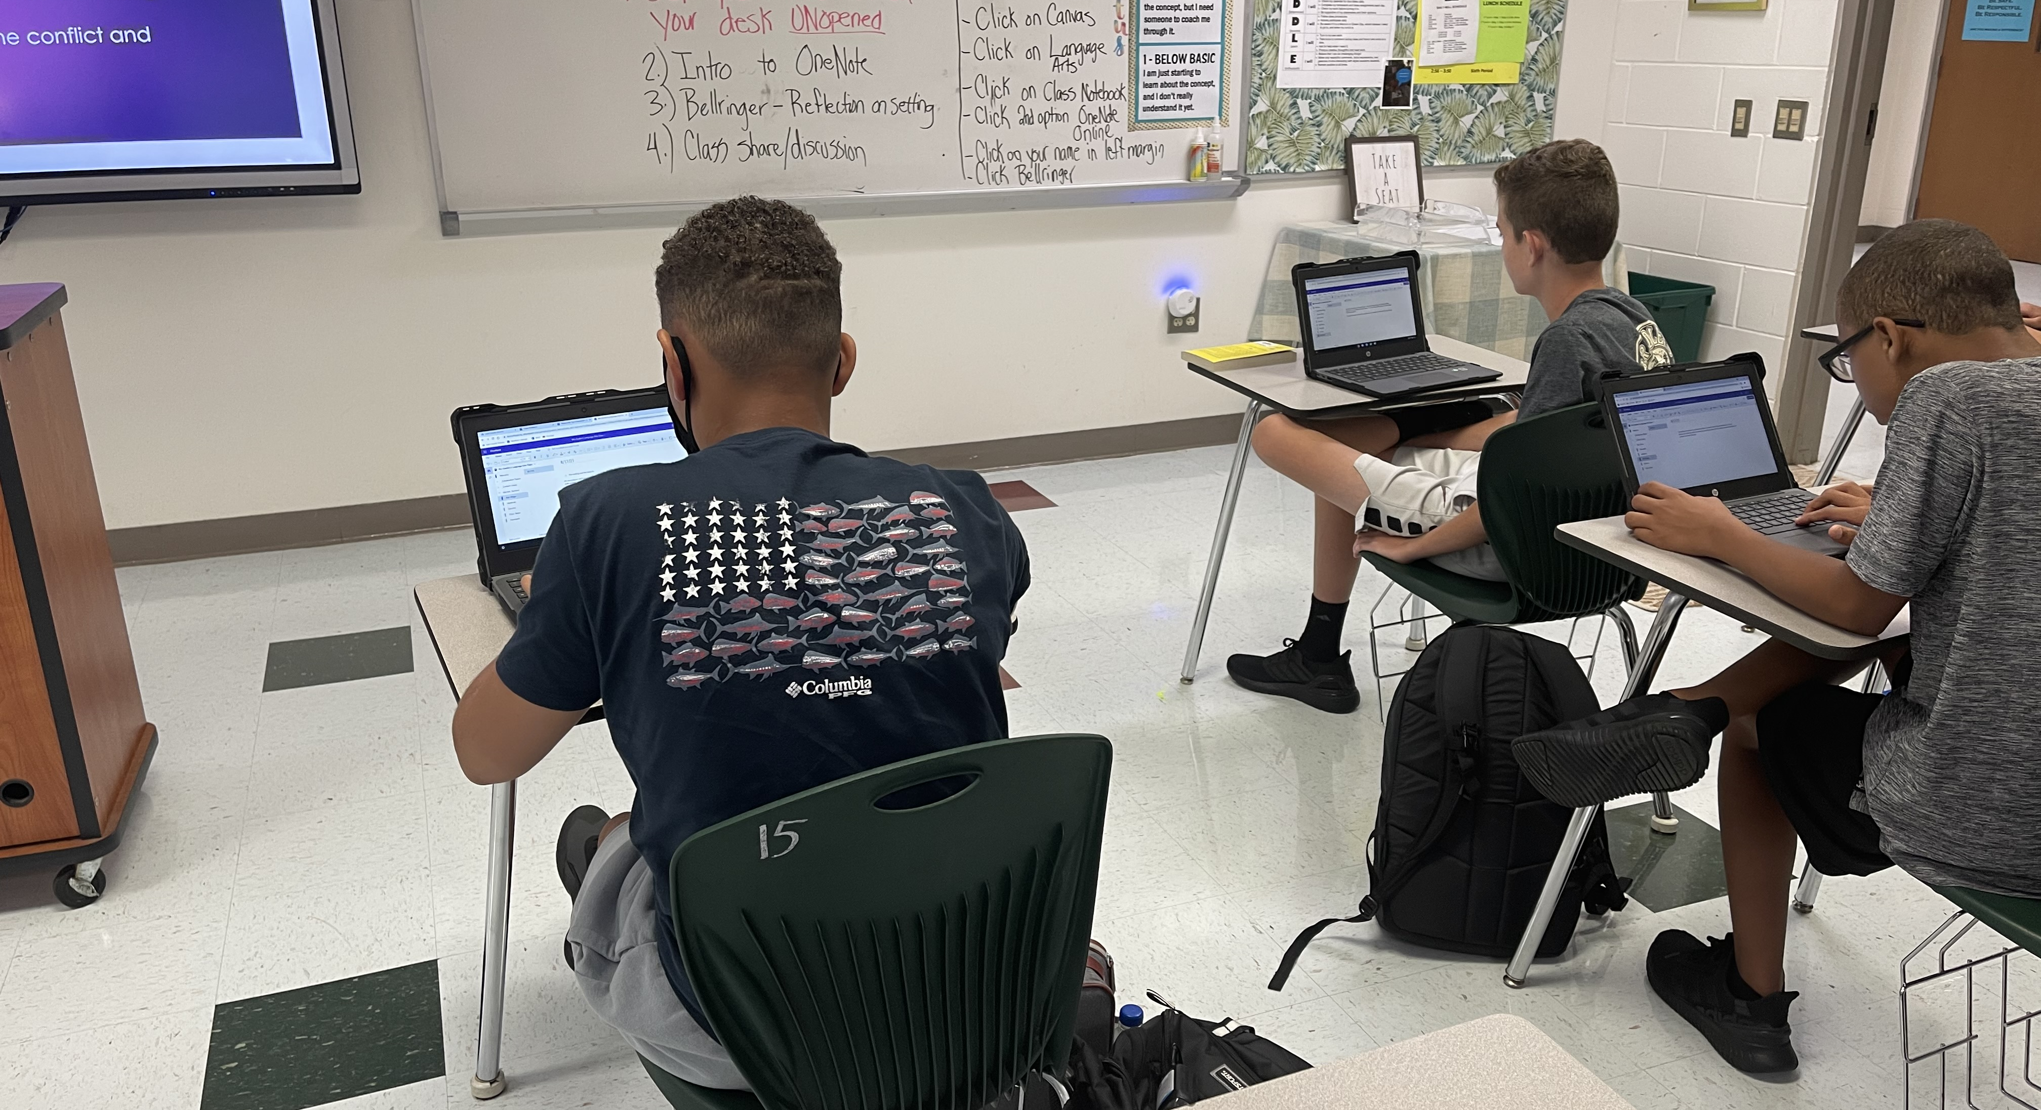
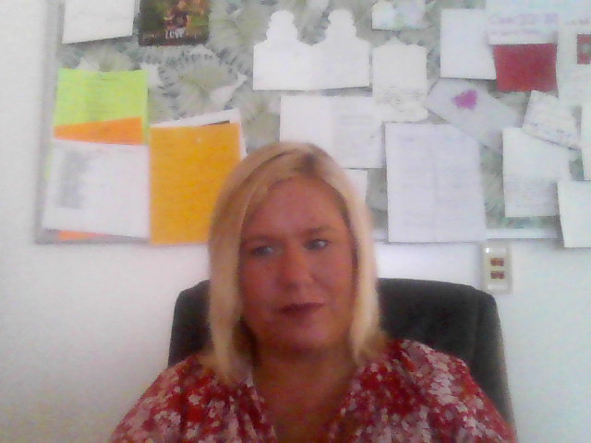
Using Technology
Chromebooks have been issued and we are enjoying using our Class Notebook through Canvas.
Notes:
*Change to Spring Fun for southern Hemisphere
Include pictures of the first term of school. Students working together/students reading books/working on projects or art, etc.

Slide 4
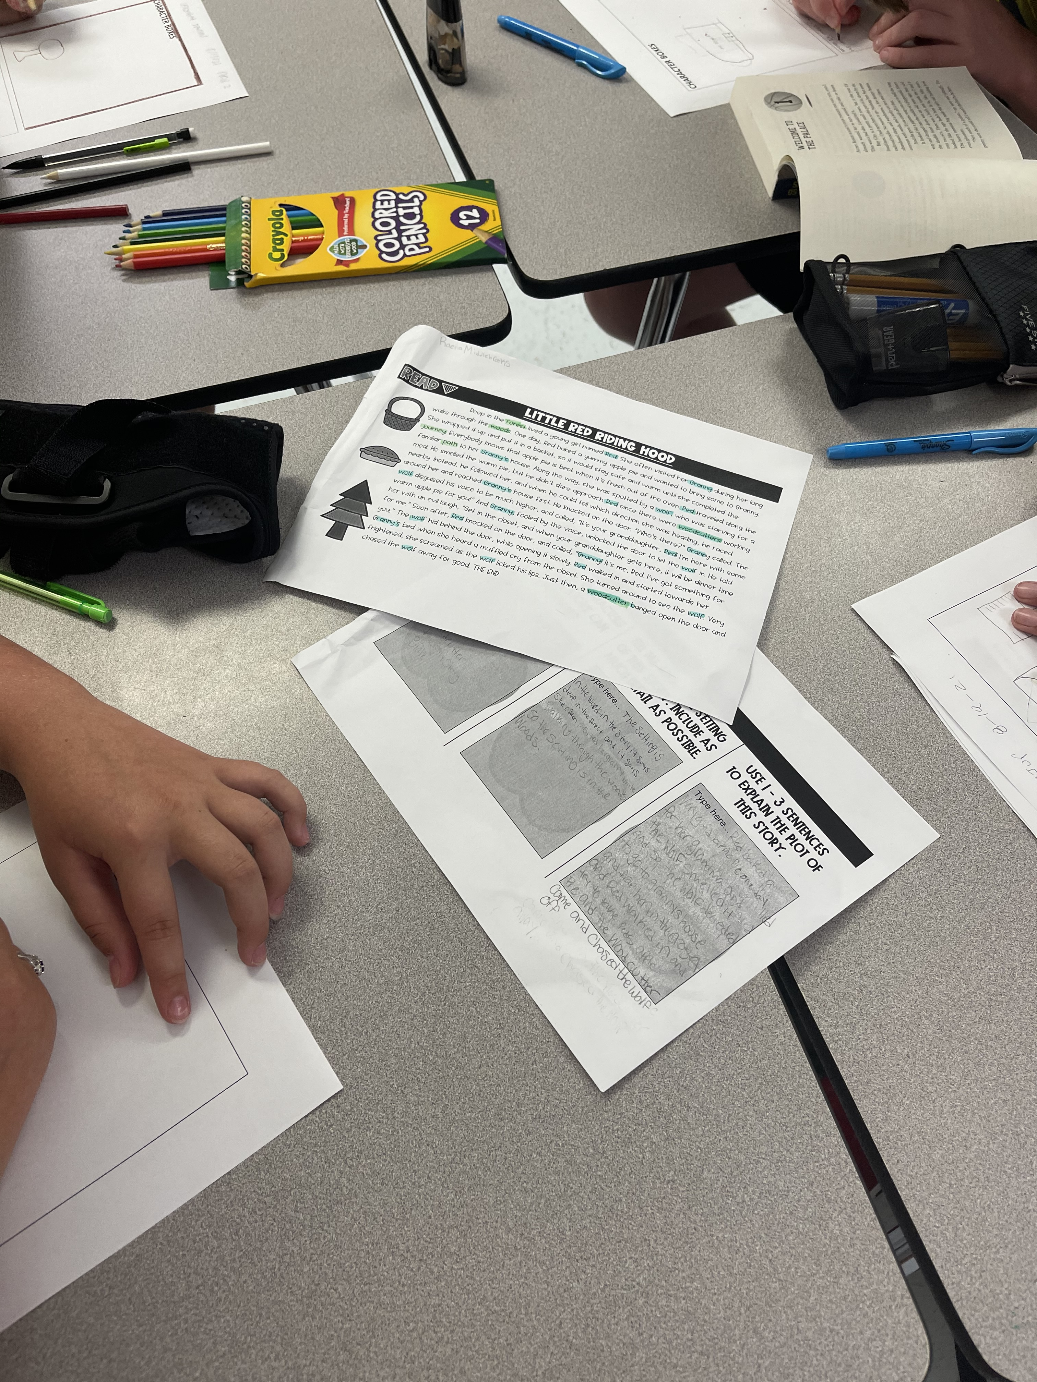
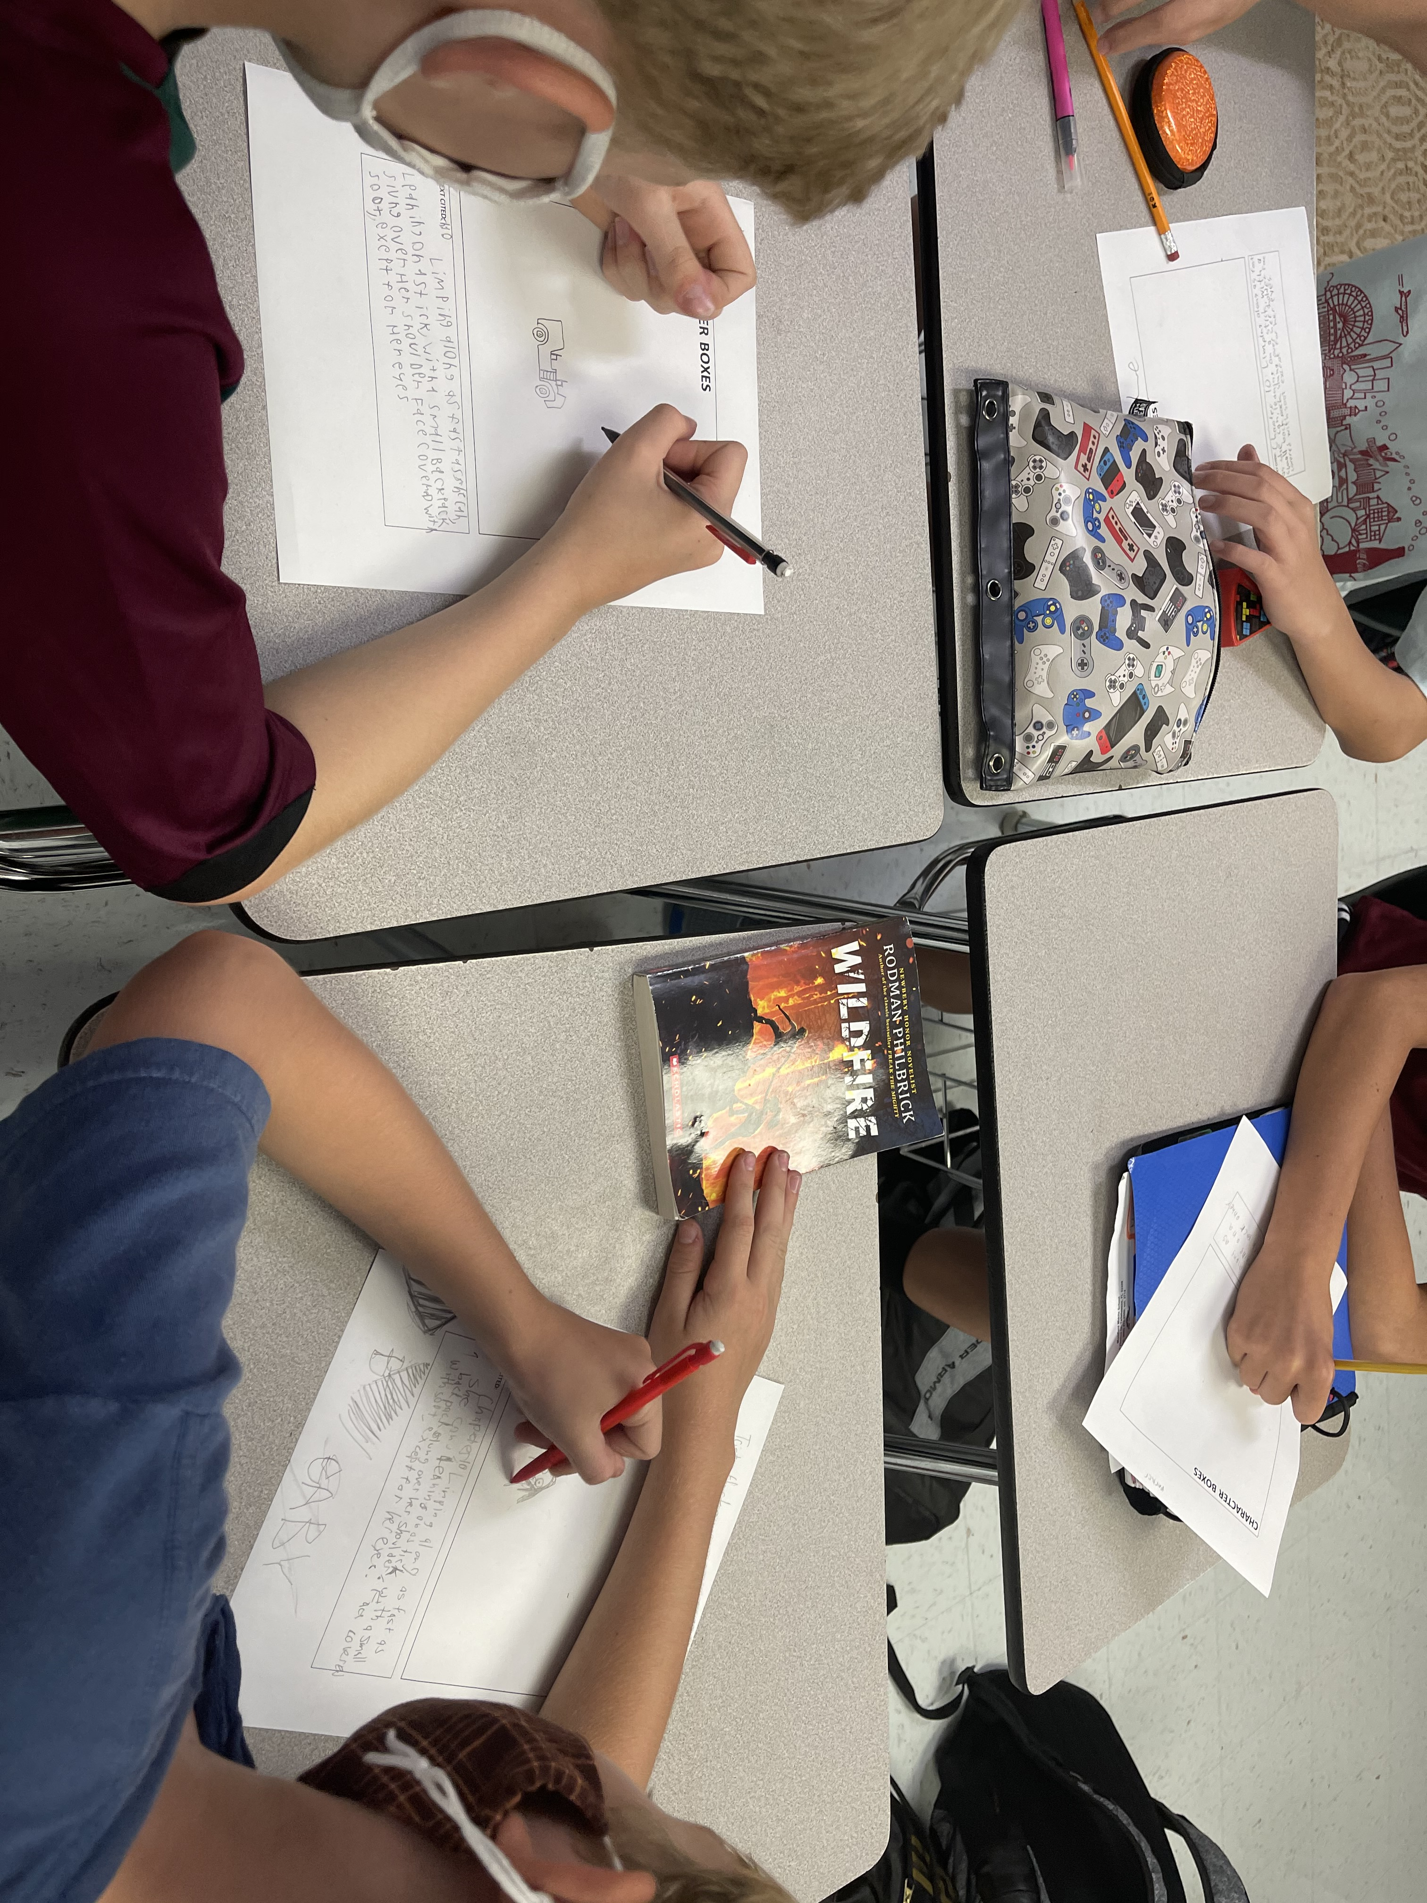

Book CLubs
Our first reading group activities are centered around our summer reading choices. We are exploring the descriptive details of setting and characters within fairytales and our summer books.
Notes:
*Out of School excursions

